Slide 1
Weekly meeting
3-7-2025
Ty Bottorff

Slide 2
Outline
NCI irAE analyses prompted by recent SI

Slide 3
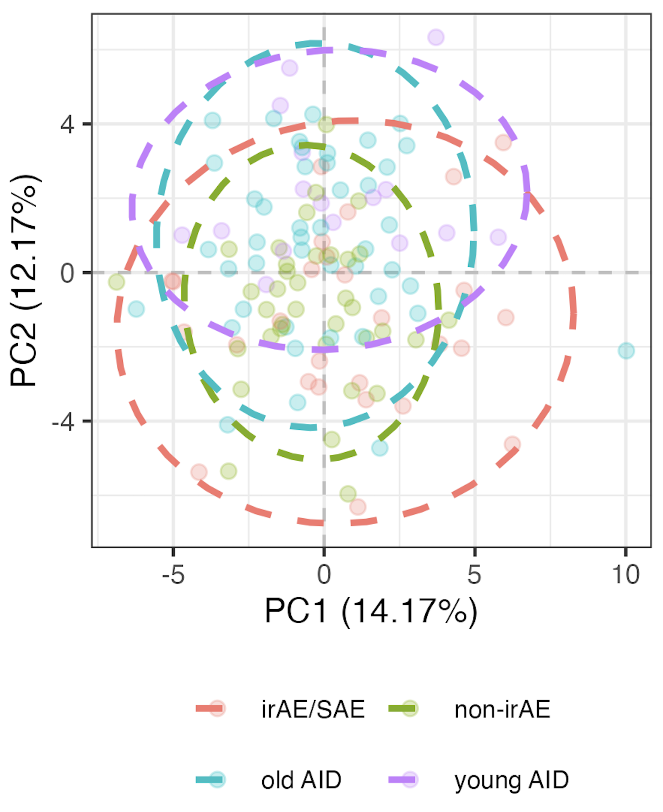
Filtering out young AID patients does not increase support for baseline irAE being more like AID
“Young”: < 44 years old (youngest ICI patient age)
Notes:
Also tried filtering out young AID for projection analyses for longitudinal shifts
Young/”old” split here is 44 yrs (youngest ICI patient)

Slide 4
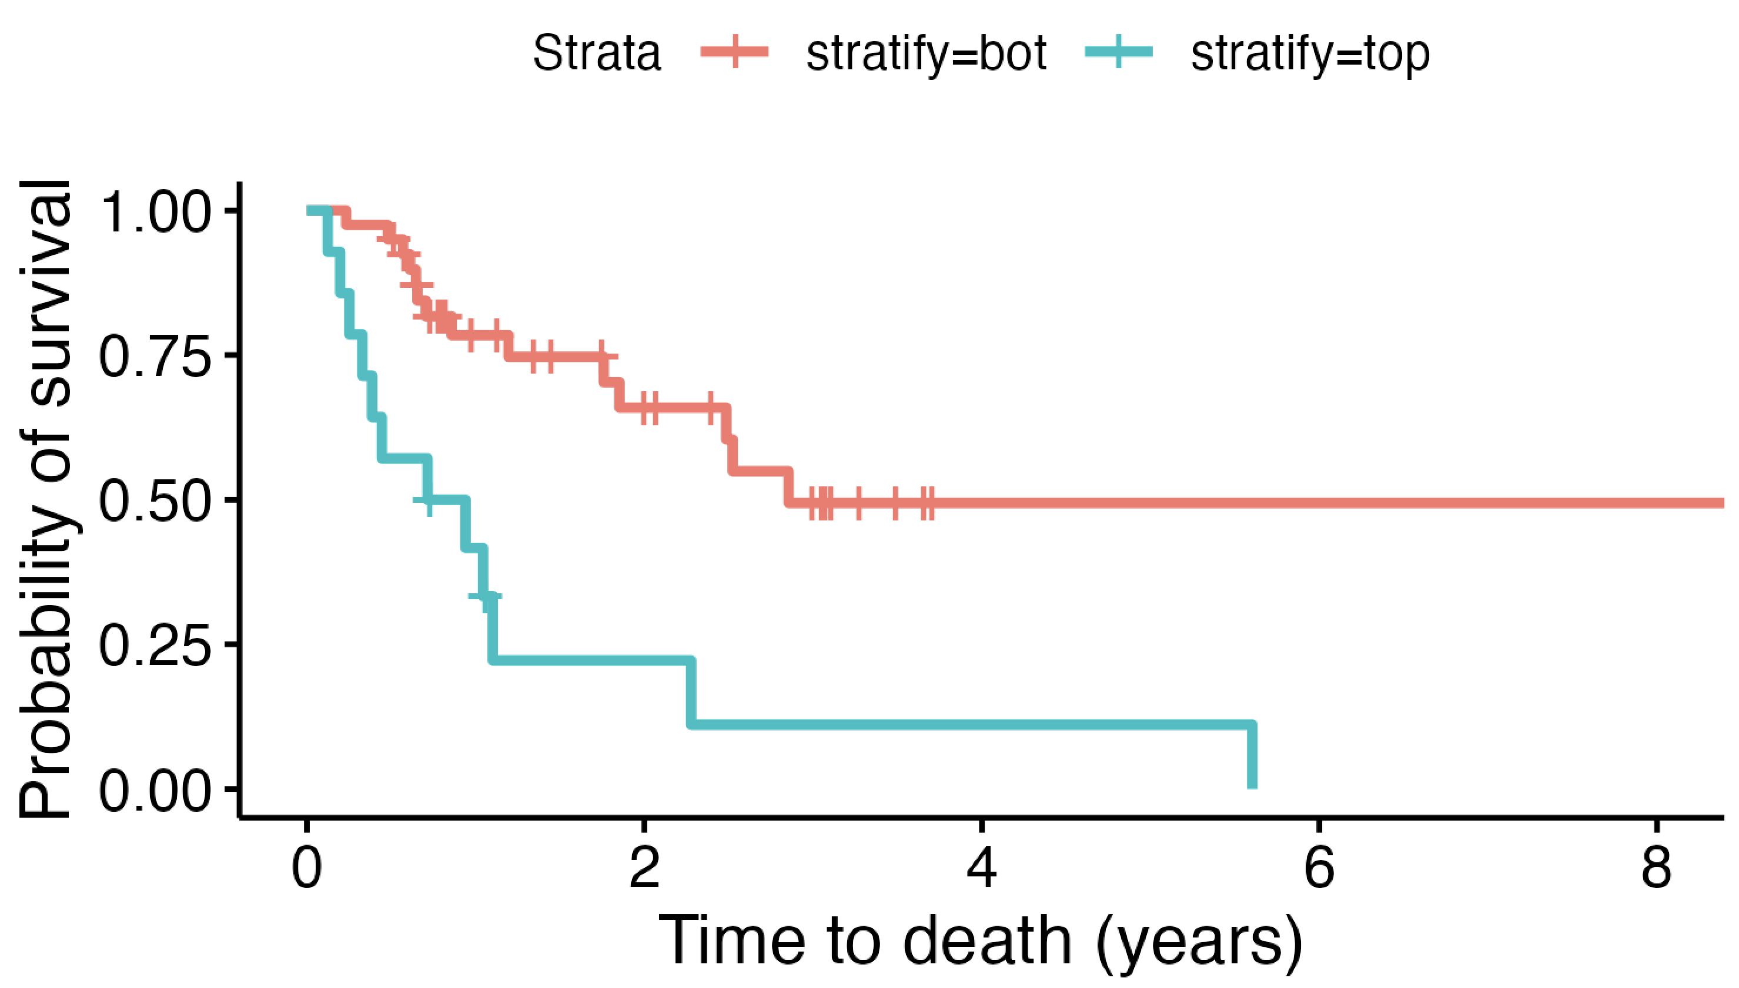
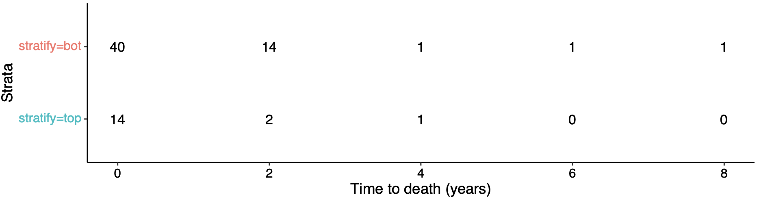
ICI patients with highest baseline frequencies of ICOS⁺ of T_{fh} T_{conv} die sooner
Bot 75%
Top 25%
padj = 0.01
Notes:
Using data lock date as end of study date
Filtered out patients who we lost contact with (don’t know if alive/dead at end date)
This doesn’t take batch effects into consideration…

Slide 5
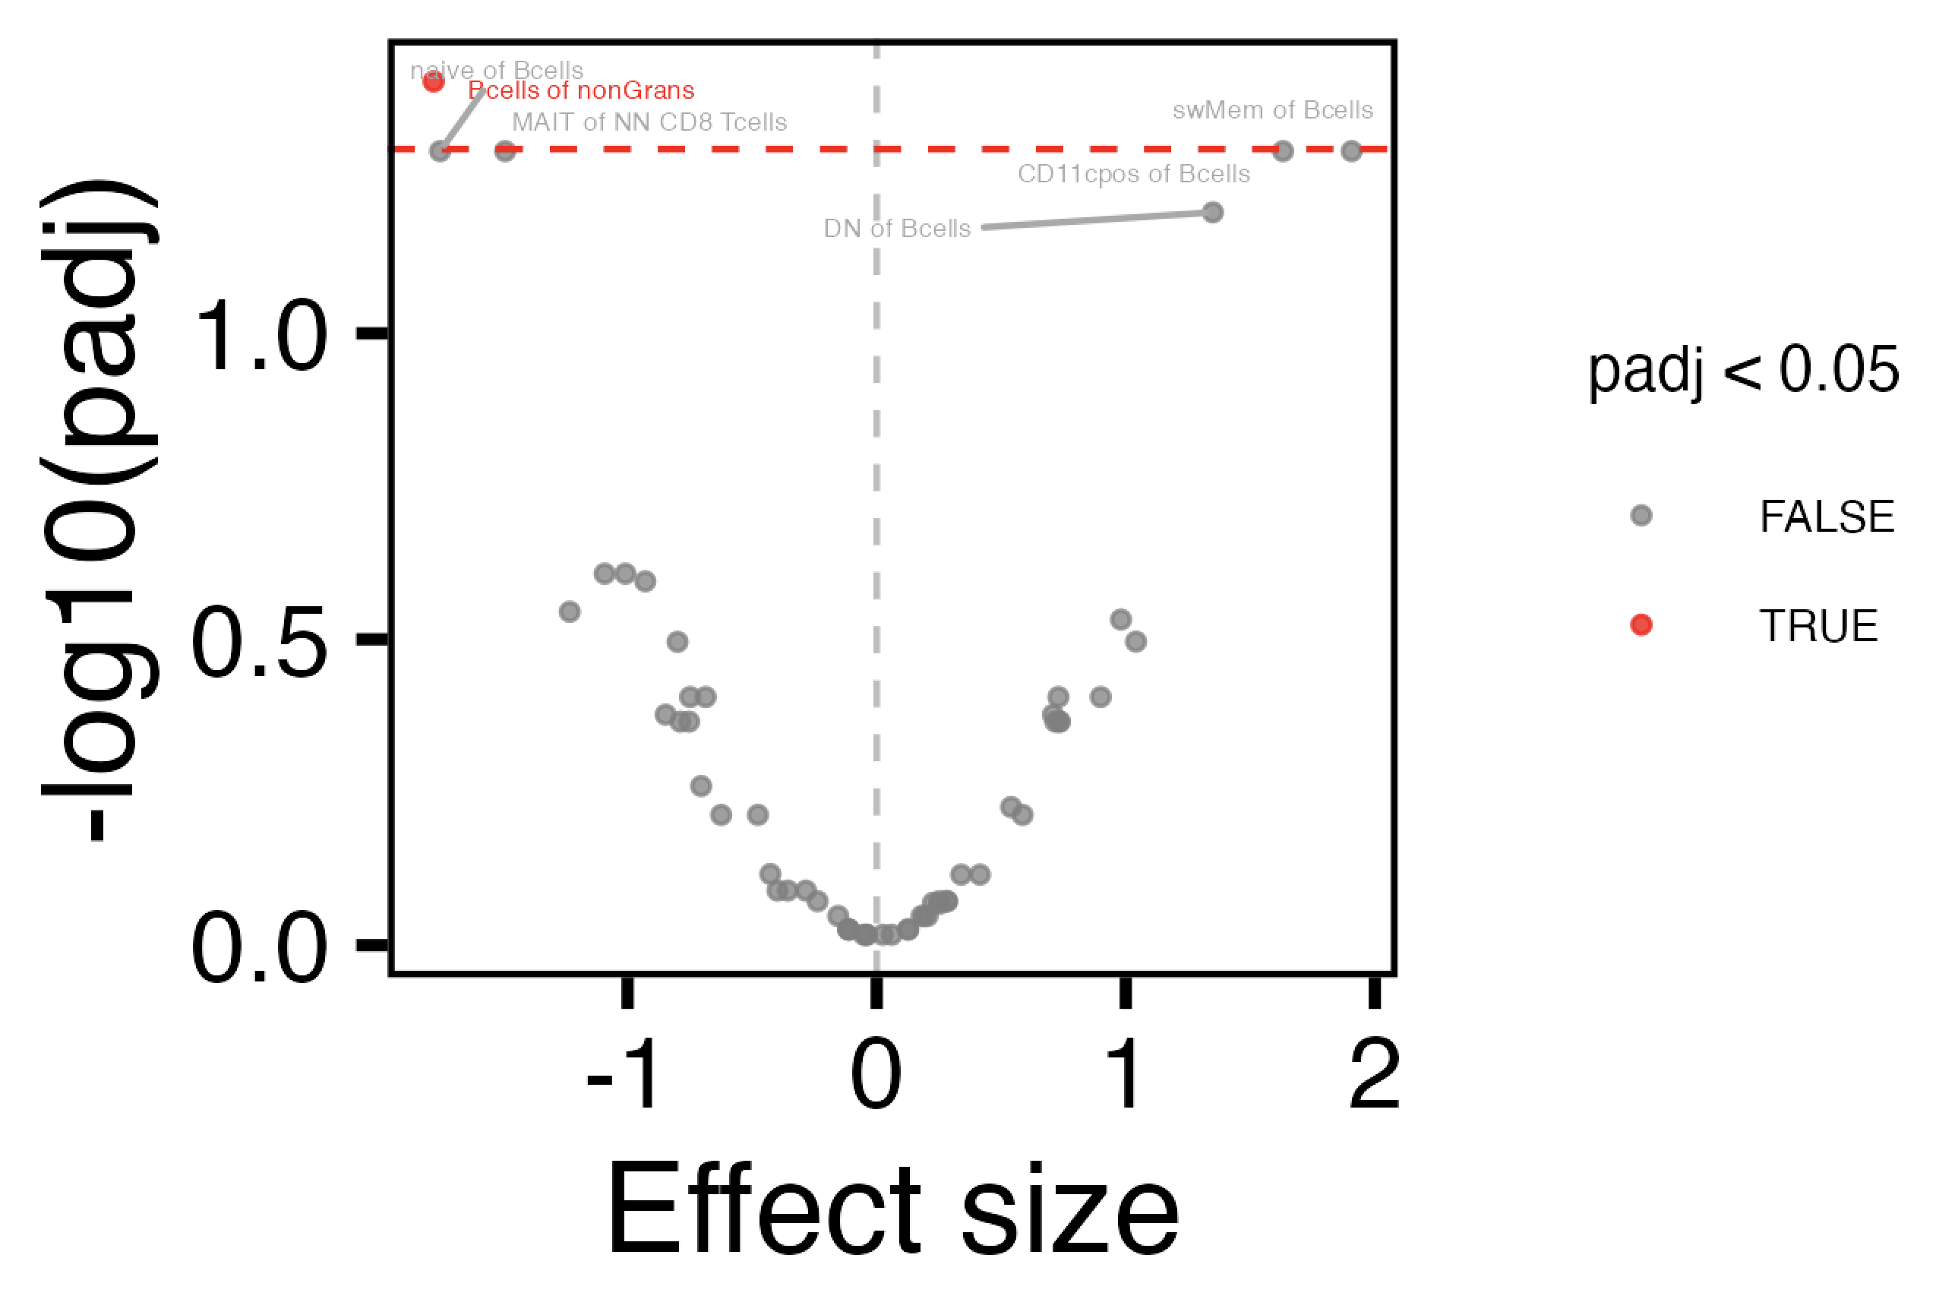
Revisiting borderline baseline combined irAE group differences
Notes:
Also see Bcells of nonGrans baseline difference for +/- skin irAE (padj < 0.05)

Slide 6
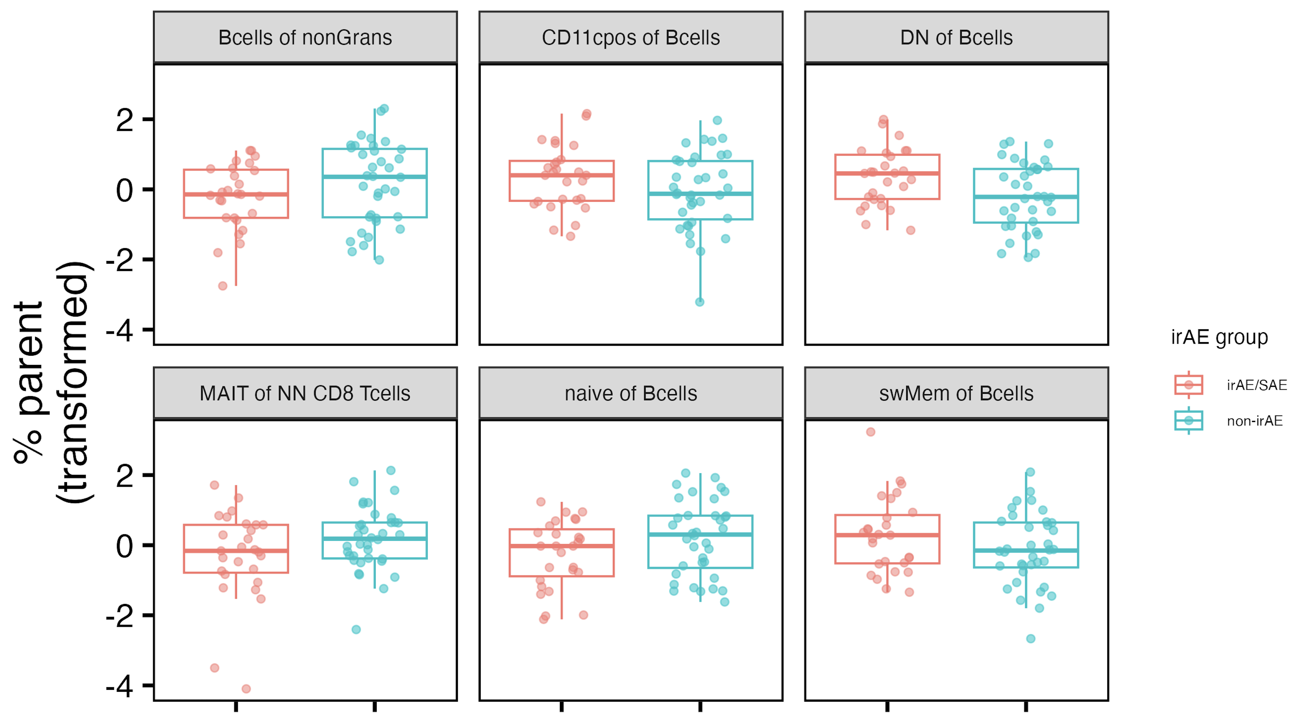
Revisiting borderline baseline combined irAE group differences
*
~*
~*
~*
~*
~*
padj < 0.05: *
padj < 0.1: ~*
Notes:
Also see Bcells of nonGrans baseline difference for +/- skin irAE (padj < 0.05)

Slide 7
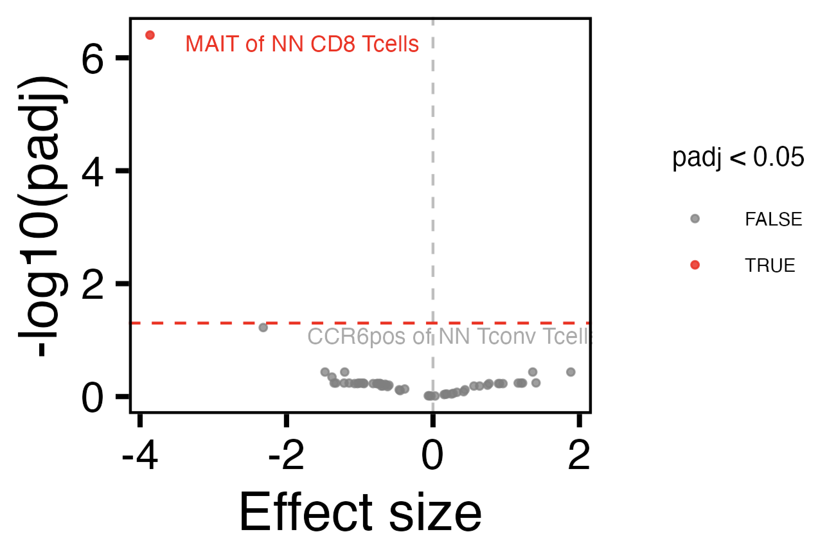
Revisiting borderline baseline thyroid irAE group differences

Slide 8
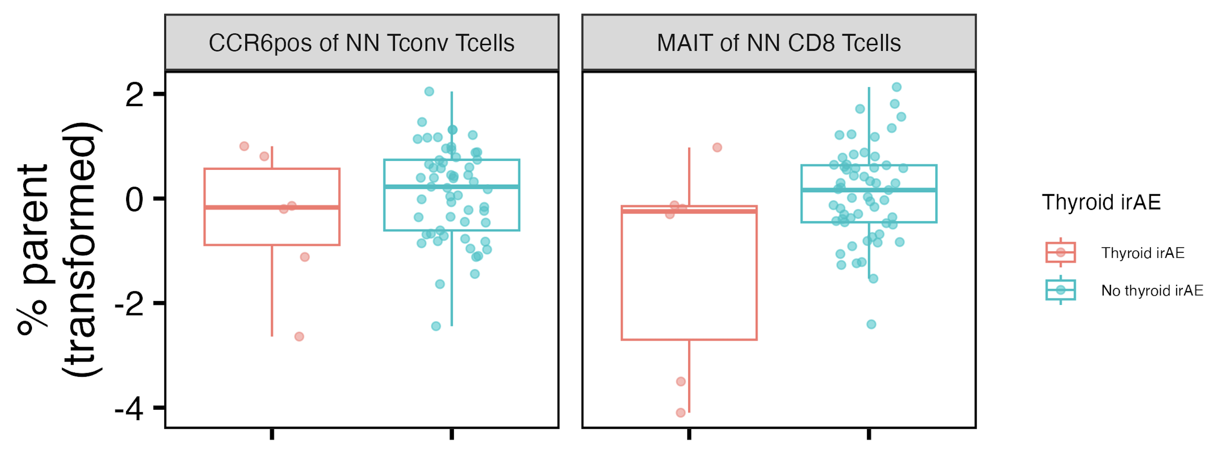
Revisiting borderline baseline thyroid irAE group differences
~*
*
padj < 0.05: *
padj < 0.1: ~*

Slide 9
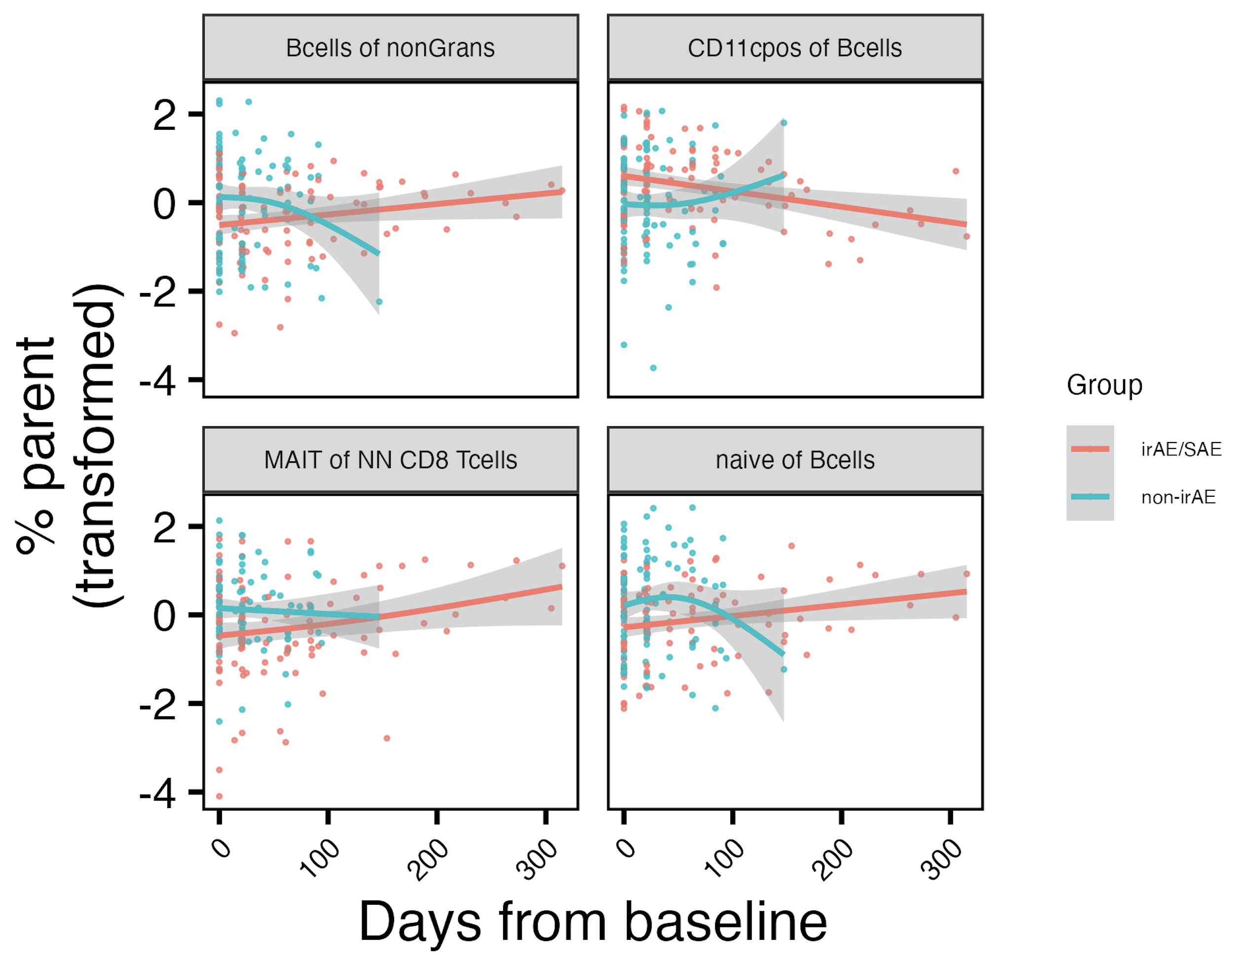
Populations changing differentially over ICI by combined irAE group
padj < 0.05 at baseline
*
*
padj < 0.1 at baseline
*
*
padj < 0.1 at baseline
padj < 0.1 at baseline
padj < 0.05: *
Notes:
Results ~changed with response in model formula too now

Slide 10
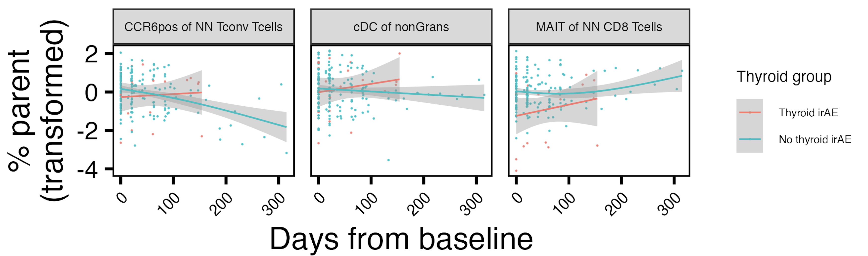
Populations changing differentially over ICI by thyroid irAE group
*
*
*
*
padj < 0.1 at baseline
padj < 0.05 at baseline
padj < 0.05: *
Notes:
Results ~changed with response in model formula too now

Slide 11
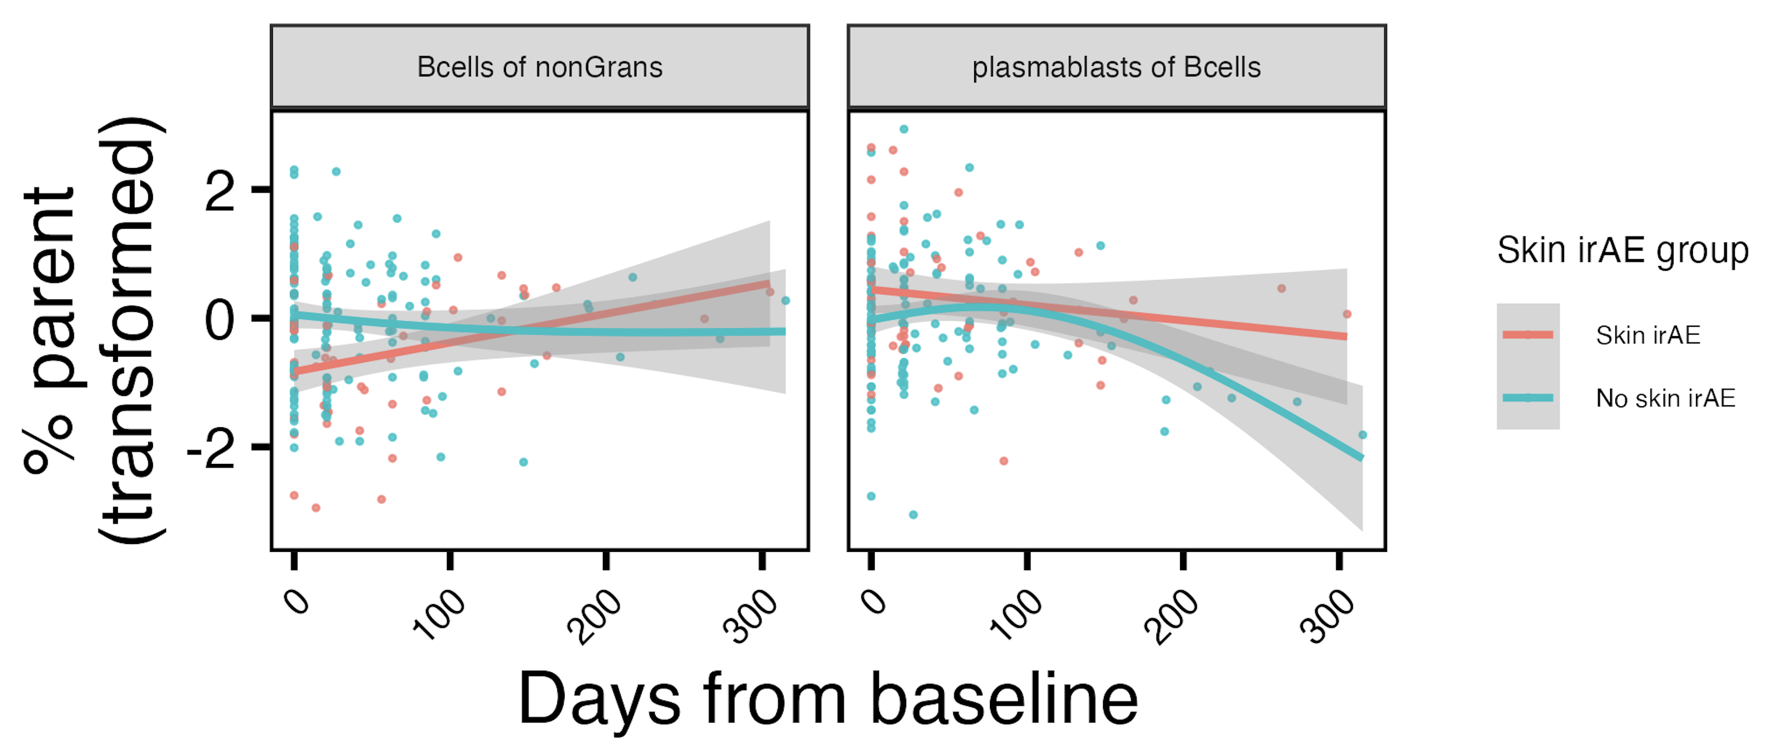
Populations changing differentially over ICI by skin irAE group
*
*
padj < 0.05 at baseline
padj < 0.05: *
Notes:
Results ~changed with response in model formula too now
Bcells of nonGrans lower at baseline in combined/skin irAE

Slide 12
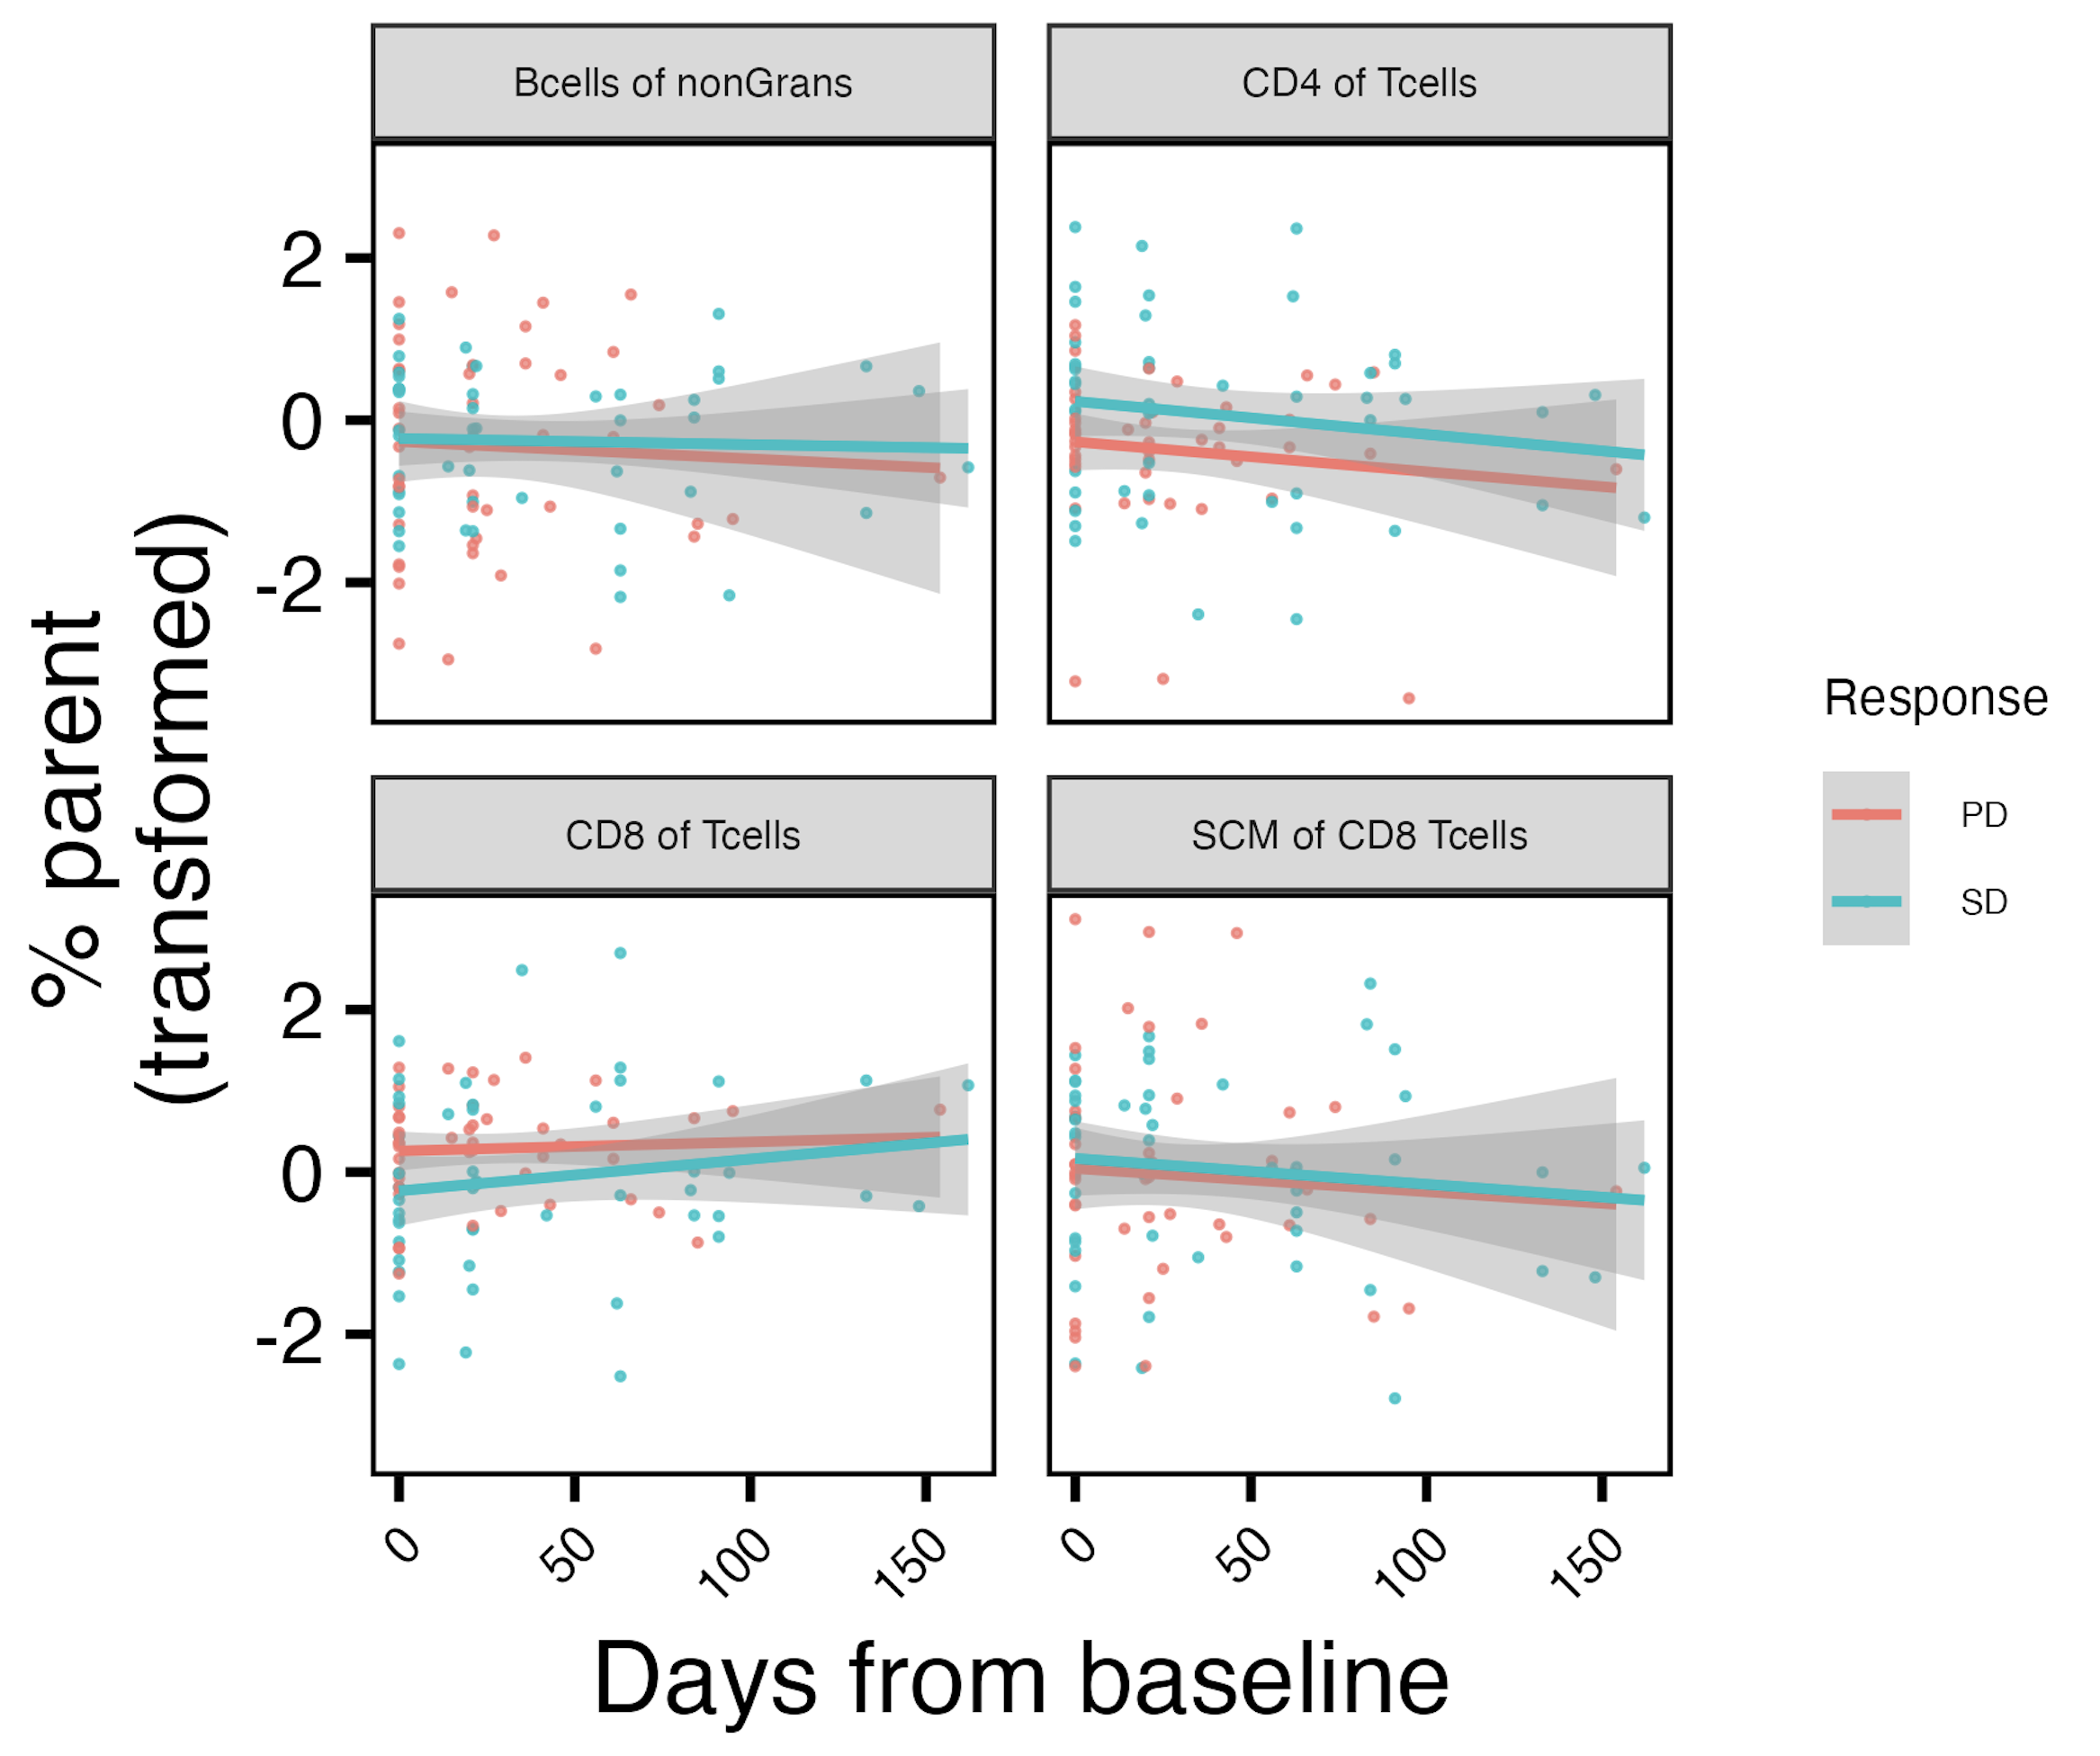
Populations changing differentially over ICI by response group
*
*
*
*
padj < 0.05: *

Slide 13
Conclusions
ICI patients with highest baseline frequencies of ICOS⁺ of T_{fh} T_{conv} die sooner

Slide 14
Next steps

